Slide 1


Charm++ Concluding remarks
Laxmikant (Sanjay) Kale
http://charm.cs.illinois.edu
Parallel Programming Laboratory
Department of Computer Science
University of Illinois at Urbana Champaign

Slide 2
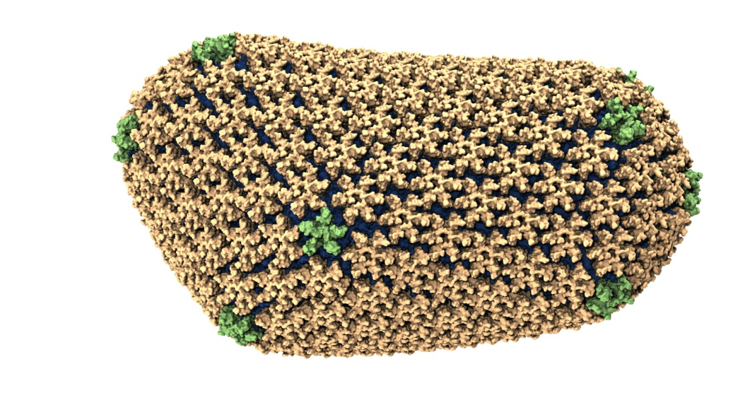
NAMD: Biomolecular Simulations
Collaboration with K. Schulten
With over 50,000 registered users
Scaled to most top US supercomputers
In production use on supercomputers and clusters and desktops
Gordon Bell award in 2002
Recent success: Determination of the structure of HIV capsid by researchers including Prof Schulten

Slide 3
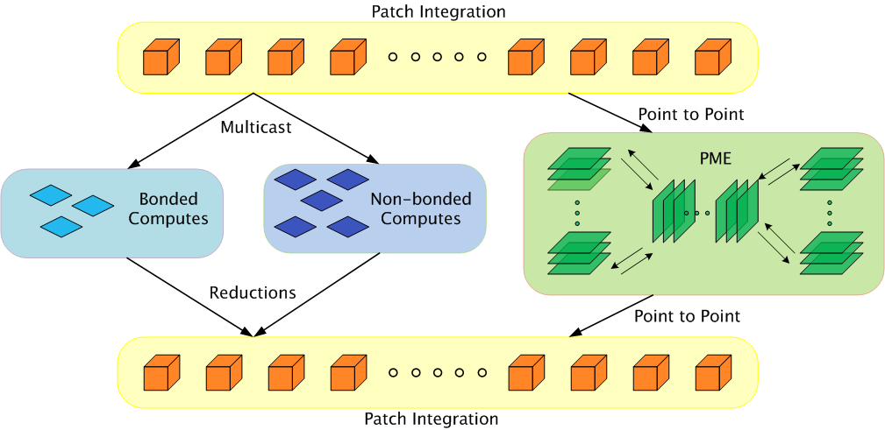
Parallelization using Charm++

Slide 4
Grainsize example: NAMD
High performing examples (objects are the work-data units in Charm++):
On Blue Waters, 100M atom simulation
128K cores (4K nodes): 5,510,202 objects
Edison, Apoa1 (92K atoms)
4K cores: 33,124 objects
Hopper, STMV (1M atoms)
15,360 cores: 430,612 objects

Slide 5
NAMD strong scaling on Titan Cray XK7, Blue Waters Cray XE6, and Mira IBM Blue Gene/Q for 21M and 224M atom benchmarks

Slide 6
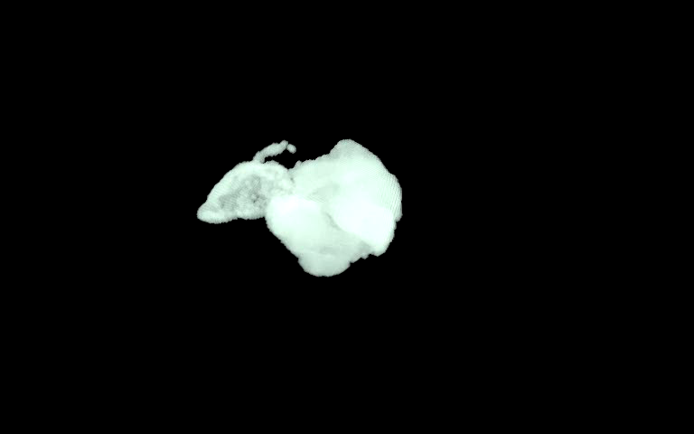
ChaNGa: Parallel Gravity
Evolution of Universe and Galaxy Formation
Collaborative project (NSF)
with Tom Quinn, Univ. of Washington
Gravity, gas dynamics
Barnes-Hut tree codes
Oct tree is natural decomp
Geometry has better aspect ratios, so you “open” up fewer nodes
But is not used because it leads to bad load balance
Assumption: one-to-one map between sub-trees and PEs
Binary trees are considered better load balanced
With Charm++: Use Oct-Tree, and let Charm++ map subtrees to processors

Slide 7
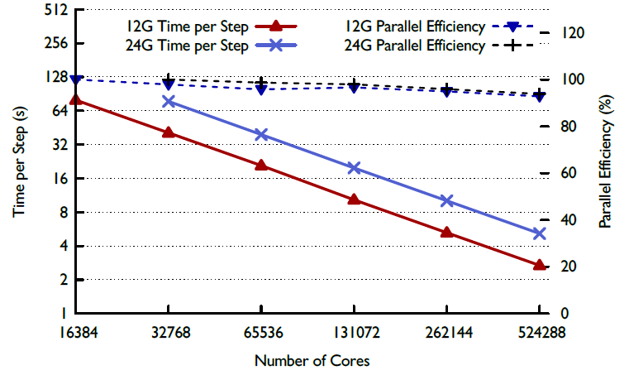
ChaNGa : a recent result

Slide 8
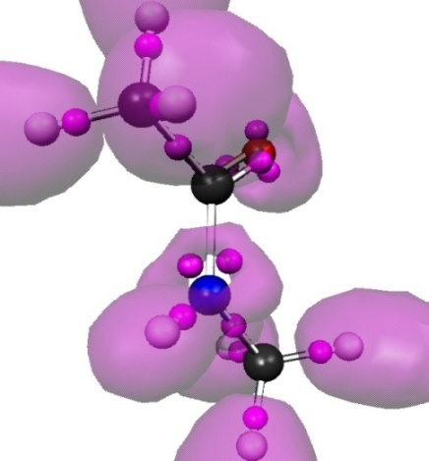
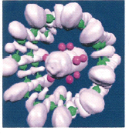
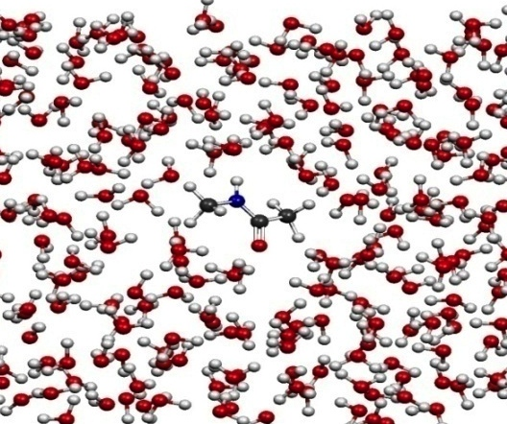
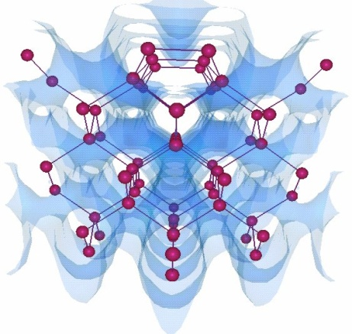
OpenAtom
Car-Parinello Molecular Dynamics
NSF ITR 2001-2007, IBM, DOE,NSF
Molecular Clusters :
Nanowires:
Recent NSF SSI-SI2 grant
With
G. Martyna (IBM)
Sohrab Ismail-Beigi
Semiconductor Surfaces:
3D-Solids/Liquids:
Using Charm++ virtualization, we can efficiently scale small (32 molecule) systems to thousands of processors

Slide 9
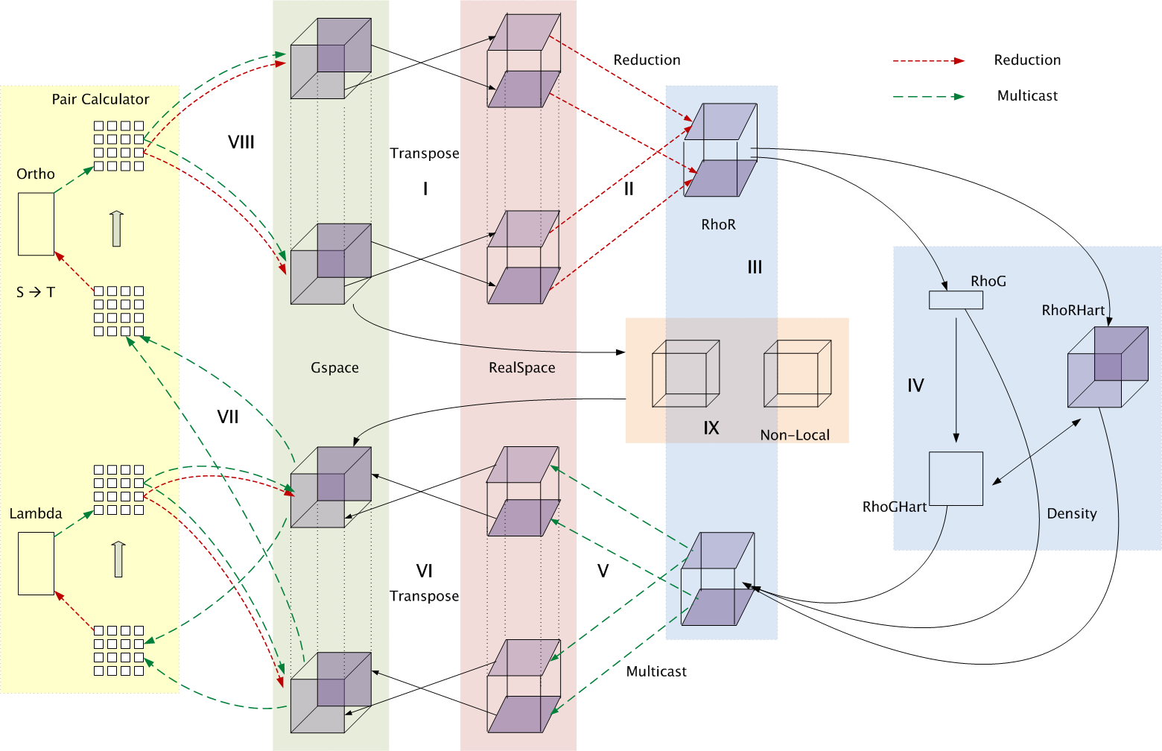
Decomposition and Computation Flow

Slide 10
MiniApps
Available at: http://charmplusplus.org/miniApps/
Mini-App | Features | Machine | Max cores
AMR | Overdecomposition, Custom array index, Message priorities, Load Balancing, Checkpoint restart | BG/Q | 131,072
LeanMD | Overdecomposition, Load Balancing, Checkpoint restart, Power awareness | BG/P BG/Q | 131,072 32,768
Barnes-Hut (n-body) | Overdecomposition, Message priorities, Load Balancing | Blue Waters | 16,384
LULESH 2.02 | AMPI, Over-decomposition, Load Balancing | Hopper | 8,000
PDES | Overdecomposition, Message priorities, TRAM | Stampede | 4,096

Slide 11
More MiniApps
Mini-App | Features | Machine | Max cores
1D FFT | Interoperable with MPI | BG/P BG/Q | 65,536 16,384
Random Access | TRAM | BG/P BG/Q | 131,072 16,384
Dense LU | SDAG | XT5 | 8,192
Sparse Triangular Solver | SDAG | BG/P | 512
GTC | SDAG | BG/Q | 1,024
SPH |  | Blue Waters | -

Slide 12
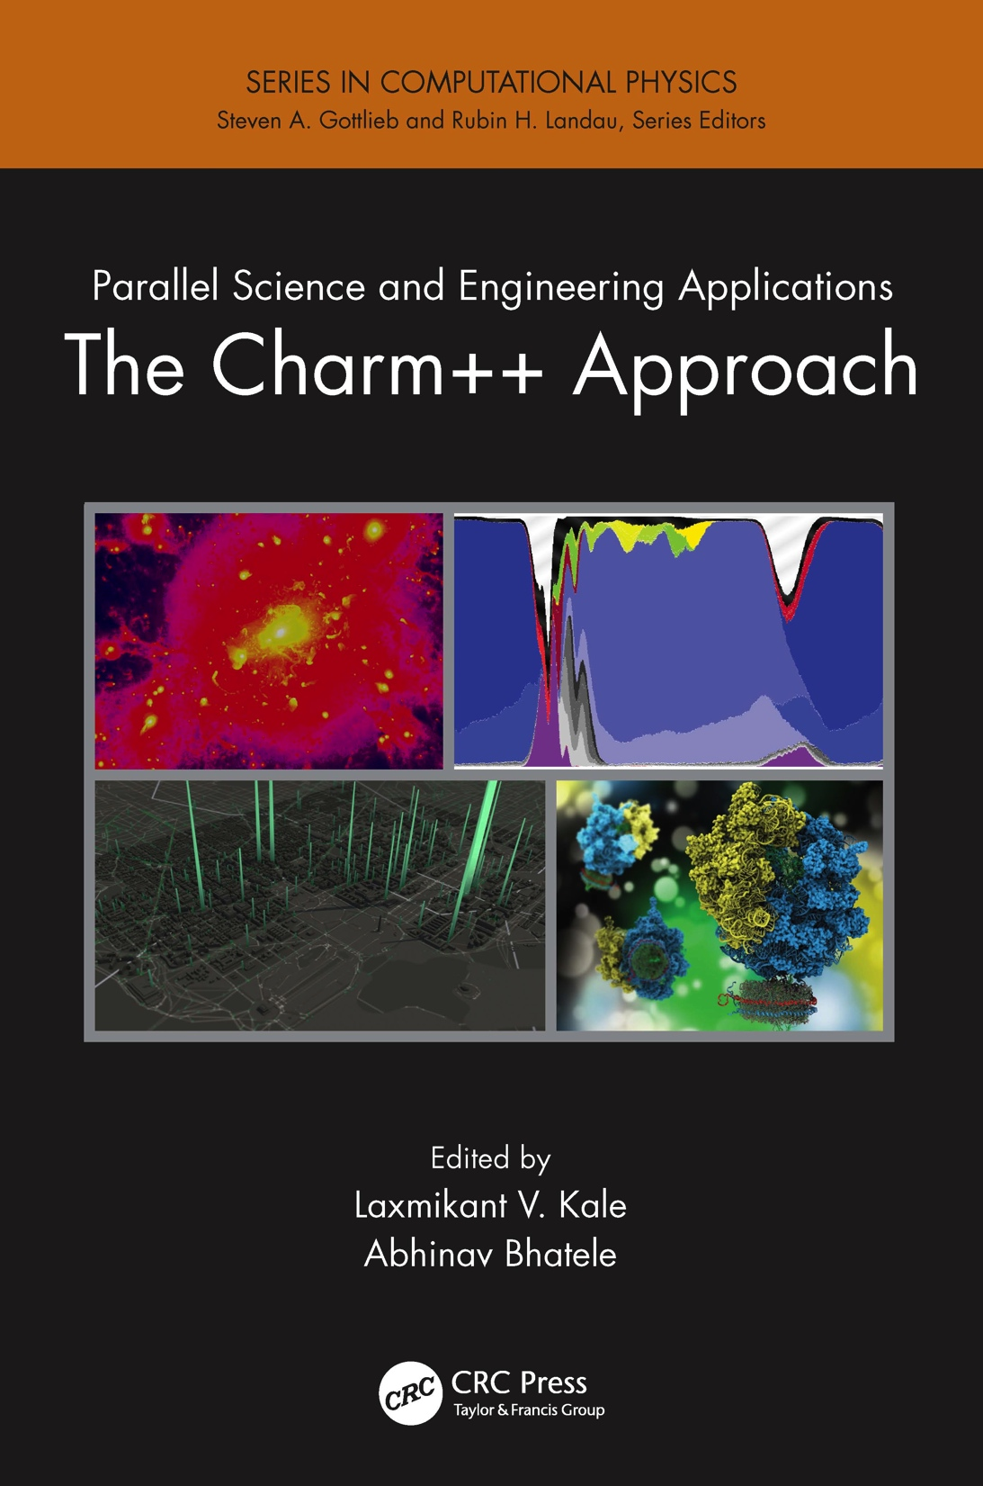
A recently published book
surveys seven major applications developed using Charm++
More info on Charm++:
http://charm.cs.illinois.edu
Including the miniApps

Slide 13
Fault Tolerance in Charm++/AMPI
Four approaches available:
Disk-based checkpoint/restart
In-memory double checkpoint w auto. restart
Proactive object migration
Message-logging: scalable fault tolerance
Common Features:
Easy checkpoint: migrate-to-disk
Based on dynamic runtime capabilities
Use of object-migration
Can be used in concert with load-balancing schemes
Notes:
13

Slide 14
Power
Power consumption is continuous
Normal Checkpoint-Resart method
Progress
Progress is slowed down with failures
Time

Slide 15
Power consumption is lower during recovery
Message logging + Object-based virtualization
Progress is faster with failures

Slide 16
Saving Cooling Energy
Easy: increase A/C setting
But: some cores may get too hot
So, reduce frequency if temperature is high (DVFS)
Independently for each chip
But, this creates a load imbalance!
No problem, we can handle that:
Migrate objects away from the slowed-down processors
Balance load using an existing strategy
Strategies take speed of processors into account
Implemented in experimental version
SC 2011 paper, IEEE TC paper
Several new power/energy-related strategies
PASA ‘12: Exploiting differential sensitivities of code segments to frequency change

Slide 17
PARM:Power Aware Resource Manager
Charm++ RTS facilitates malleable jobs
PARM can improve throughput under a fixed power budget using:
overprovisioning (adding more nodes than conventional data center)
RAPL (capping power consumption of nodes)
Job malleability and moldability

Slide 18
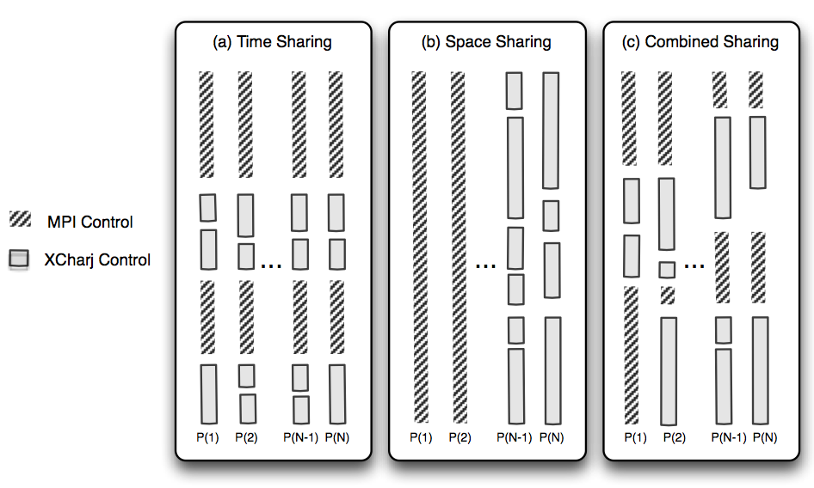
Charm++ interoperates with MPI
Charm++ Control

Slide 19
Summary
Charm++ embodies an adaptive, introspective runtime system
Many applications have been developed using it
NAMD, ChaNGa, Episimdemics, OpenAtom, …
Many miniApps, and third-party apps
Adaptivity developed for apps is useful for addressing exascale challenges
Resilience, power/temperature optimizations, ..
More Info: http://charm.cs.illinois.edu/ (including the miniApps)
Overdecomposition
Asynchrony
Migratability

